Slide 1
Measurement as a Tool of Research
Measurement: limiting the data of any phenomenon—substantial or insubstantial—so that those data may be interpreted and, ultimately, compared to a particular qualitative or quantitative standard.
Substantial measurements = those things being measured that have physical substance.
Insubstantial measurements = exist only as concepts, ideas, opinions, feelings, or other intangible entities.
Leedy & Ormrod
Practical Research: Planning and Design, 10e
© 2013 Pearson Education, Inc. All rights reserved.
1-0

Slide 2
Measurement
Requires valid and reliable instruments
to measure physical characteristics – rulers, scales, speedometers, etc.
to measure the impact of social and psychological phenomena – tests and questionnaires.
Leedy & Ormrod
Practical Research: Planning and Design, 10e
© 2013 Pearson Education, Inc. All rights reserved.
1-1

Slide 3
Statistics as a Tool of Research
Main Functions of Statistics:
1. describe the data
2. draw inferences from the data
Descriptive Statistics summarize the general nature of the data obtained.
Inferential Statistics help the researcher make
decisions about the data.
Leedy & Ormrod
Practical Research: Planning and Design, 10e
© 2013 Pearson Education, Inc. All rights reserved.
1-2

Slide 4
Language as a Tool of Research
A tool to communicate and think more effectively
Words have multiple meaning. Clarity is essential in research writing.
Knowing two or more languages in valuable.
Following guidelines for research writing is essential.
Using features of word processing makes revisions more efficient.
Leedy & Ormrod
Practical Research: Planning and Design, 10e
© 2013 Pearson Education, Inc. All rights reserved.
1-3

Slide 5
Language as a Tool of Research
Words enhance thinking by:
- reducing the world’s complexity,
- allowing abstraction of the environment,
- enhancing the power of thought,
- facilitating generalization and inference
drawing in new situations.
Leedy & Ormrod
Practical Research: Planning and Design, 10e
© 2013 Pearson Education, Inc. All rights reserved.
1-4

Slide 6
Communicating Effectively Through Writing
Say exactly what you mean.
Keep your primary objective in mind at all times.
Provide an overview of what you will be discussing.
Organize ideas into general and more specific categories by using headings and subheadings.
Use transitional phrases, sentences, or paragraphs to help readers follow your train of thought.
Leedy & Ormrod
Practical Research: Planning and Design, 10e
© 2013 Pearson Education, Inc. All rights reserved.
1-5

Slide 7
Communicating Effectively Through Writing
Use concrete examples to make abstract ideas more understandable.
Use appropriate punctuation.
Use figures and tables for clarification.
At the end of chapters and major sections, summarize what you’ve said.
Anticipate having to write multiple drafts.
Leedy & Ormrod
Practical Research: Planning and Design, 10e
© 2013 Pearson Education, Inc. All rights reserved.
1-6

Slide 8

Reasoning Tools for Research
Critical Thinking
Deductive Logic
Inductive Reasoning
The Scientific Method
Theory Building
Leedy & Ormrod
Practical Research: Planning and Design, 10e
© 2013 Pearson Education, Inc. All rights reserved.
1-7

Slide 9

Critical Thinking
Components of Critical Thinking:
- verbal reasoning
- argument analysis
- decision making
- critical analysis of prior research
Ask Questions….:
-What does it mean ?
-What does it mean to you?
- What are examples / use-cases?
- How does this apply to real life?
-- and so on.
Leedy & Ormrod
Practical Research: Planning and Design, 10e
© 2013 Pearson Education, Inc. All rights reserved.
1-8

Slide 10
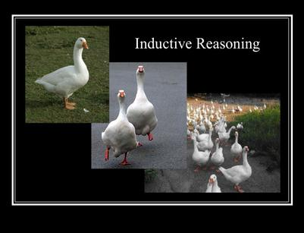
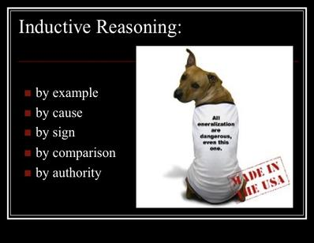
Inductive Reasoning
reasoning from detailed facts to general principles. Also called “bottom up” reasoning.
Leedy & Ormrod
Practical Research: Planning and Design, 10e
© 2013 Pearson Education, Inc. All rights reserved.
1-9

Slide 11
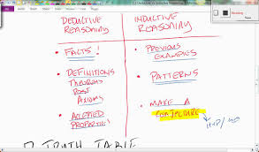
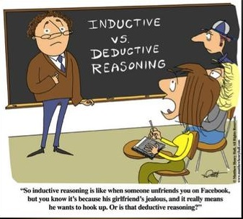
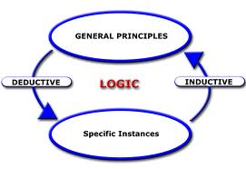
Inductive vs Deductive Reasoning
Leedy & Ormrod
Practical Research: Planning and Design, 10e
© 2013 Pearson Education, Inc. All rights reserved.
1-10

Slide 12
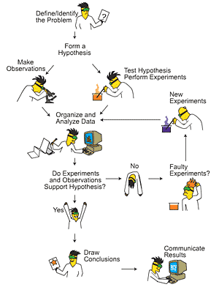
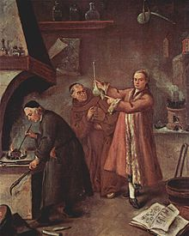
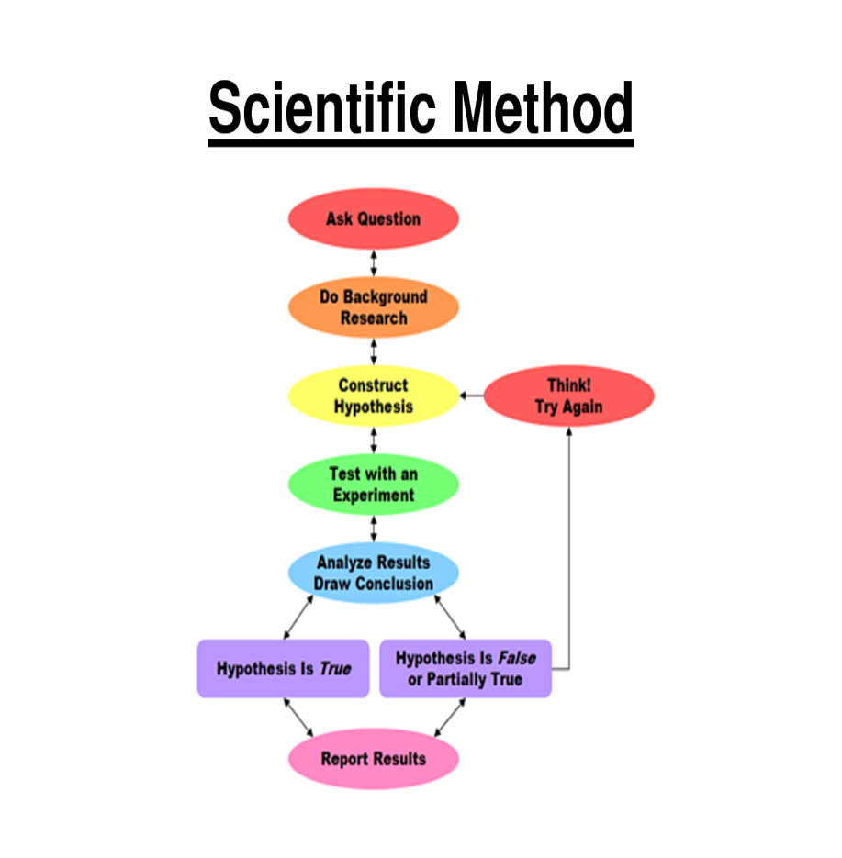
The Scientific Method:
The scientific method is a set of techniques for investigating phenomena, acquiring new knowledge, or correcting and integrating previous knowledge
Leedy & Ormrod
Practical Research: Planning and Design, 10e
© 2013 Pearson Education, Inc. All rights reserved.
1-11

Slide 13
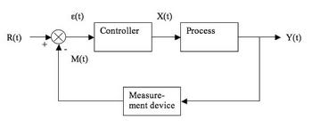
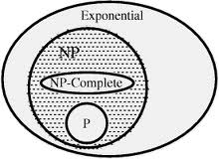
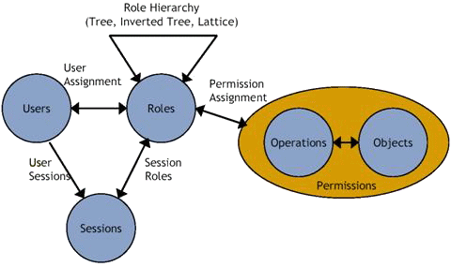

Theory Building
Theory Building is people making sense of the world around them. We all do it all the time. Kids build theory about where they come from.
Leedy & Ormrod
Practical Research: Planning and Design, 10e
© 2013 Pearson Education, Inc. All rights reserved.
1-12

Slide 14
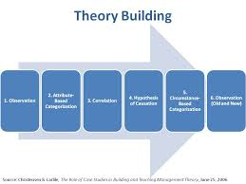
Theory Building Continuing…
What it takes to build a theory?
Steps:
1. Observe
2. Organize
3. Find Co-relation
4. Create hypothesis
5. Justify Hypothesis
6. Build Model
Leedy & Ormrod
Practical Research: Planning and Design, 10e
© 2013 Pearson Education, Inc. All rights reserved.
1-13

Slide 15

Human Mind as Tools of Research
Eventually, it is you who decide.
Leedy & Ormrod
Practical Research: Planning and Design, 10e
© 2013 Pearson Education, Inc. All rights reserved.
1-14

Slide 16

Collaboration collaboration Brings Power.
Who to Collaborate with:
Friends?
Colleagues?
faculties?
Industries?
and so on…
Leedy & Ormrod
Practical Research: Planning and Design, 10e
© 2013 Pearson Education, Inc. All rights reserved.
1-15

Slide 17



Doing Research – last of all motivation…. After all we have to do the research for the graduation, good profession and probably a happy family.
Leedy & Ormrod
Practical Research: Planning and Design, 10e
© 2013 Pearson Education, Inc. All rights reserved.
1-16

